Slide 1
ME759 High Performance Computing for Applications in Engineering [Spring 2020]
Lecture 28
04/03/2020
Dan Negrut, 2020 ME759 UW-Madison

Slide 2
Things to do, for Canvas live-session
Dan: start the Canvas recording
Everybody else:
Please mute your microphone
Please ask questions (limit: two per person per lecture; after that, post on Piazza)
When you ask questions, first unmute your mic

Slide 3
Quote of the day
“Human beings only use ten percent of their brains. Ten percent! Can you imagine how much we could accomplish if we used the other sixty percent?”
Ellen DeGeneres, American comedian, television host, actress, writer, and producer [1958 - ]

Slide 4
And how “Quote of the Day” applies to ME759
In most cases, we use 10% of the compute power at our disposal. Ten percent! Can you imagine what we could accomplish if we used the other 60 %?
That’s what ME759 is all about – using the other 60%.
Dan Negrut, Romanian instructor, television host, actor, writer, and producer [1968 - ]

Slide 5
Before we get going…
Last time:
MPI: point-to-point communication
MPI_Send, MPI_Ssend, MPI_Bsend, MPI_Rsend
MPI_Receive
Today:
Wrap up MPI P2P communication
Nonblocking flavors
MPI collective communication
ME759 wrap up
Other tidbits:
ME759 Exam: April 15, at 7:15 PM, in Canvas
Review: Tu, April 14, at 7:00 PM, in Canvas
Final Project Proposal feedback went out on Wd
This is last ME759 lecture
Last assignemnt goes out today; due next Friday, 9PM

Slide 6
ME759: Final Exam related
Exam is comprehensive
Exam: “open everything”
Exam requirement: you should not communicate w/ anybody for the duration of the exam
You’ll have to electronically sign and date this statement: “I have neither given nor received, nor have I tolerated others’ use of unauthorized aid on this exam.”
Exam pertains material that was either covered in the PPT slides or part of the homework
Assigned reading is for you to know more, but no probing there
When: April 15, 04/15/2020, 7:15PM – 9:15PM
Exam is online

Slide 7
ME759: Final Exam related
For taking the exam, you’ll need:
Fully charged or plugged laptop that can connect to the internet
A good/reliable internet connection
Access to Canvas
Final Exam format:
A set of 20-30 multiple-choice questions
Some four or so other problems where you need to think and provide an answer
You might have to write pseudo-code, or look at a piece of code and answer questions
You will not have to write code, compile it, link, etc.
Link to sample exam (do not read too much into this, might be changed without notice)

Slide 8
ME759: Review session for the Final Exam
Review for exam
Tu, April 14, at 7:00 PM, in Canvas
I will record the session, for those of you who can’t make it
Questions to be compiled in a forum post. We’ll go through questions until we cover them all
Link to forum thread where you can post questions: https://piazza.com/class/k5crmnymtx95c0?cid=363
Please post your questions in advance

Slide 9
Non-blocking, P2P Communication

Slide 10
P2P Communication: Drawbacks of the MPI_Send (and friends)
Two problems with plain vanilla blocking send/receive covered thus far (that is, Send, Ssend, Bsend, Rsend):
When MPI “send” function is called, calling rank is blocked (there is no overlap of compute & data movement) (calling rank needs to wait until the send completed, which can be a while)
If not done properly, the processes executing the MPI code can hang
There is a second class of send/receive operations, which eliminates the two issues above (but brings in others)
Called “non-blocking” sends/receives

Slide 11
Send/Receives: Blocking vs. Non-blocking [important slide]
MPI send/receive operations: classified as blocking or non-blocking
Blocking send: upon return from a send operation, you can modify the content of the buffer in which you stored data to be sent since the data has been sent
MPI_Send, MPI_Ssend, MPI_Bsend, MPI_Rsend
Non-blocking send: the send call returns immediately; there is no guarantee that the data has actually been transmitted upon return from send call
MPI_Isend, MPI_Issend, MPI_Ibsend, MPI_Irsend
The blocking/non-blocking receive op has the same semantics
Upon return from a non-blocking receive call, it’s not clear whether the receive buffer has fresh data in it

Slide 12
Non-Blocking P2P Communication: How things play out
There’s three acts to the “non-blocking communication” play:
Initiate non-blocking communication
Returns Immediately
Routine name starting with MPI_I…
The calling rank gets to do some other useful work upon return from non-blocking call
This allows for the “latency hiding”
Later, wait for non-blocking communication to complete (accomplished via a synchronization call)
Bottom line: Like with CUDA kernel launch, you can overlap communication with execution

Slide 13
P2P Communication: The looming danger w/ non-blocking MPI_Isend
The “I” flavor switches you to an asynchronous operation mode. Improves efficiency, but no free lunch
If non-blocking, then data “lives” in your buffer – think twice before changing its content since not clear when transaction has completed. This means it’s not clear when it’s safe to mess with the content of the buffer
There are mechanisms to check for MPI_Isend completion (to give you a green light to change its content)
However, they add overhead :-(
Same looming issue for “receive” as well…
Notes:
DN: What is this slide???

Slide 14
Non-blocking Send/Receive
There was no such thing in the good old MPI_Send (and the other blocking flavors)
Syntax
int MPI_Isend(void *buf, int count, MPI_Datatype datatype, int dest, int tag, MPI_Comm comm, MPI_Request *req);
buf - [in] initial address of send buffer (choice)
count - [in] number of elements in send buffer (integer)
datatype - [in] datatype of each send buffer element (handle)
dest - [in] rank of destination (integer)
tag - [in] message tag (integer)
comm - [in] communicator (handle)
req - [out] communication request (handle)
int MPI_Irecv(void *buf, int count, MPI_Datatype datatype, int source, int tag, MPI_Comm comm, MPI_Request *req);
For the good old MPI_Recv, this used to be MPI_Status

Slide 15
Non-Blocking Send/Receive: Tools of the Trade
Key observation: the nonblocking call returns immediately. Therefore, user must worry whether …
Data to be sent is out of the send buffer before trampling over the buffer
Data to be received has arrived before using the content of the buffer
Tools that will come in handy for immediate sends & receives:
MPI_Wait – blocking: once called, makes you wait till a certain request completed
MPI_Test – non-blocking: returns quickly with status information
These helper tools: all use the MPI_Request object – it is like the “fingerprint” of a certain MPI operation
You use this fingerprint as input when you want to find information about the status of the MPI operation

Slide 16
The Screenplay: Non-Blocking P2P Communication
Non-blocking send
MPI_Isend(...)
do some other work here
MPI_Wait(...)
0
Non-blocking receive
MPI_Irecv(...)
do some other work here
MPI_Wait(...)
1
= waiting until operation locally completed
[ICHEC]→

Slide 17
Waiting for Isend/Ireceive to complete
Waiting on a single send
int MPI_Wait(MPI_Request *request, MPI_Status *status);
Waiting on multiple sends (get status of all)
Till all complete, as a barrier
int MPI_Waitall(int count, MPI_Request *requests, MPI_Status *statuses);
Till at least one completes
int MPI_Waitany(int count, MPI_Request *requests, int *index, MPI_Status *status);
Helps manage progressive completions
int MPI_Waitsome(int incount, MPI_Request *requests, int *outcount, int *indices, MPI_Status *statuses);
[IN]
[OUT]
[Alexander]→

Slide 18
MPI_Test
When completed, flag is true
int MPI_Test(MPI_Request *request, int *flag, MPI_Status *status);
Similar in meaning to MPI_Waitsome, except nonblocking
int MPI_Testsome(int incount, MPI_Request *requests, int *outcount, int *indices, MPI_Status *statuses);
int MPI_Testall(int count, MPI_Request *requests, int *flag, MPI_Status *statuses);
int MPI_Testany(int count, MPI_Request *requests, int *index, int *flag, MPI_Status *status);
[IN]
[OUT]
[OUT]
[Alexander]→

Slide 19
Another helper: MPI_Probe / MPI_Iprobe
The MPI_PROBE and MPI_IPROBE operations allow incoming messages to be queried prior to receiving them
The user can then decide how to receive them, based on the information returned by the probe
The information of interest returned in the status handler
In particular, user may allocate memory for the receive buffer, according to the length of the probed message

Slide 20
Probe prior to receive
Function comes in two flavors: blocking and non-blocking
Blocking probing, wait till match
int MPI_Probe(int source, int tag, MPI_Comm comm, MPI_Status *status);
Non-blocking probing, flag set to true if ready
int MPI_Iprobe(int source, int tag, MPI_Comm comm, int *flag, MPI_Status *status);
[Alexander]→

Slide 21
MPI P2P Communication: Take Away Points
Two types of communication:
Blocking:
Safe to change content of buffer holding on to data in the MPI send call
Non-blocking:
Be careful with the data in the buffer, since you might step on/use it too soon
MPI provides four modes for these two types
standard, synchronous, buffered, ready
Beware of possible deadlock

Slide 22
Quiz
How is MPI_Issend supposed to work?
How is MPI_Ibsend supposed to work?
Starts a nonblocking buffered send
Notes:
MPI_Issend:
Starts a nonblocking synchronous send
No eager mode for this guy
MPI_Ibsend:
- Starts a nonblocking buffered send

Slide 23
Outline, Parallel Computing w/ MPI
Introduction to message passing and MPI
Point-to-Point Communication
Collective Actions
MPI Closing Remarks

Slide 24
Collective Actions
Collective Actions: MPI actions involving a group of processes
Thus far, we’ve talked about P2P communication only
Must be called by all processes in a communicator
Many collective actions come in two flavors (just like P2P communication)
Blocking (covered in these slides)
Non-blocking - just like the “I” version of MPI_Send; i.e., MPI_Isend. Not covered here

Slide 25
Collective Actions
Three types of MPI Collective Actions:
Collective Synchronization (barrier synchronization)
Collective Communication (broadcast, scatter, gather, etc.)
Collective Operation (reduce, prefix scan, user-defined, etc.)

Slide 26
Collective Actions: Synchronization Barrier
Used implicitly or explicitly to synchronize processes
all here?
[ICHEC]→

Slide 27
Collective Actions: Synchronization Barrier
Function prototype:
MPI_Barrier not needed that often:
All synchronization is done automatically by data communication (when using blocking actions)
When using blocking actions, a process cannot continue before it has the data that it needs
If barriers used for debugging, remember to remove for production release
int MPI_Barrier(MPI_Comm comm);

Slide 28
Collective Actions: Communication, Broadcast-type
Broadcast: A one-to-many communication
[ICHEC]→

Slide 29
Communication Action: Broadcast
Function prototype:
int MPI_Bcast( void *buf, int count, MPI_Datatype datatype, int root, MPI_Comm comm);
before bcast
r
e
d
after bcast
r
e
d
r
e
d
r
e
d
r
e
d
r
e
d
root=1
rank of the sending process
must be given identically by all ranks
[ICHEC]→

Slide 30
MPI_Bcast
data (buffer)
data (buffer)
A₀
A₀
processes
processes
A₀
broadcast
A₀
A₀
A₀
A₀
A₀ : any chunk of contiguous data described with MPI_Datatype and count

Slide 31
MPI_Bcast
Function prototype:
int MPI_Bcast (void *buffer, int count, MPI_Datatype type, int root, MPI_Comm comm);
INOUT : buffer (starting address, as usual)
IN : count (number of entries in buffer)
IN : type (can be user-defined)
IN : root (rank of broadcast root)
IN : com (communicator)
Broadcasts message from root to all processes (including root)
comm and root must assume identical values in all processes
On return, contents of buffer is copied to all processes in comm

Slide 32
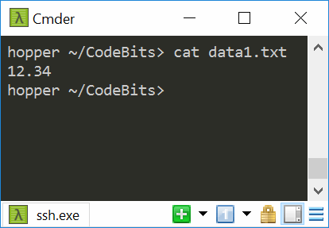
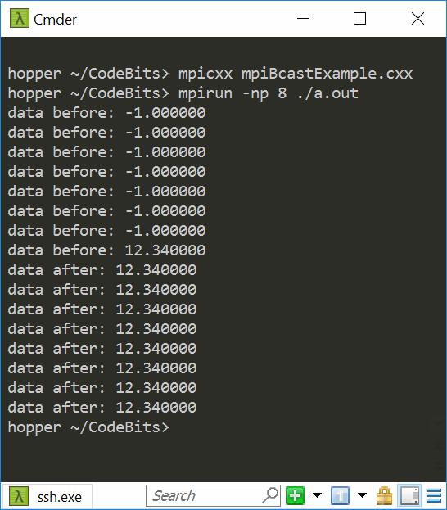
Example, MPI_Bcast
#include <mpi.h>
#include <stdio.h>
#include <stdlib.h>
// Read parameter from file and send to all processes
void main(int argc, char** argv){
int myRank, nprocs;
float data = -1.0;
FILE* file;
MPI_Init(&argc, &argv);
MPI_Comm_size(MPI_COMM_WORLD, &nprocs);
MPI_Comm_rank(MPI_COMM_WORLD, &myRank);
if( myRank==0 ) {
char input[100];
file = fopen("data1.txt", "r");
fscanf(file, "%s\n", input);
fclose(file);
data = atof(input);
}
printf("data before: %f\n", data);
MPI_Bcast(&data, 1, MPI_FLOAT, 0, MPI_COMM_WORLD);
printf("data after: %f\n", data);
MPI_Finalize();
}

Slide 33
Communication Action: Gather
Function Prototype
int MPI_Gather(void *sndbuf, int sndcount, MPI_Datatype sndtype, void *rcvbuf, int rcvcount, MPI_Datatype rcvtype, int root, MPI_Comm comm);
before gather
A
B
C
D
E
after gather
A
B
C
D
E
A
B
C
D
E
root=1
rank of the collecting process
must be given identically by all ranks
[ICHEC]→

Slide 34
MPI_Gather
data (buffer)
data
A₀
A₀
A₁
A₂
A₃
A₄
A₅
processes
processes
A₁
A₁
A₂
Gather
A₂
A₃
A₃
A₄
A₄
A₅
A₅
[A. Siegel]→

Slide 35
MPI_Gather
Function prototype:
int MPI_Gather (void *sndbuf, int sndcount, MPI_Datatype sndtype, void *rcvbuf, int rcvcount, MPI_Datatype rcvtype, int root, MPI_Comm comm);
IN sndbuf (starting address of send buffer)
IN sndcount (number of elements in send buffer)
IN sndtype (type)
OUT rcvbuf (address of receive buffer)
IN rcvcount (number of elements gathered from each party)
IN rcvtype (data type of recv buffer elements)
IN root (rank of receiving process)
IN comm (communicator)

Slide 36
MPI_Gather
Each process sends content of sndbuf to the root process
NOTE: Root receives and stores in rank order
Remarks:
Receive buffer argument ignored for all non-root processes (also rcvtype, etc.)
rcvcount on root indicates number of items received from each process, not total. Common error
[A. Siegel]→

Slide 37
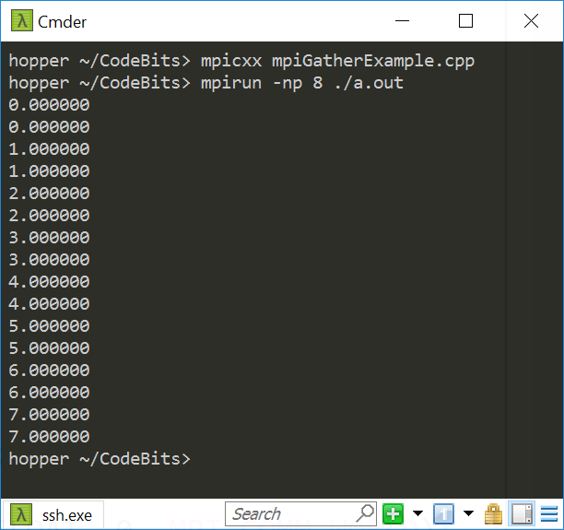
Example, MPI_Gather
#include <mpi.h>
#include <stdlib.h>
#include <stdio.h>
void main(int argc, char** argv){
int myRank, nprocs, n_loc=2, i;
float *data, *data_loc;
MPI_Init(&argc, &argv);
MPI_Comm_size(MPI_COMM_WORLD, &nprocs);
MPI_Comm_rank(MPI_COMM_WORLD, &myRank);
/* local array size on each proc = n_loc */
data_loc = (float*) malloc(n_loc*sizeof(float));
for (i = 0; i < n_loc; i++) data_loc[i] = myRank;
if (myRank == 0)
data = (float*) malloc(nprocs * n_loc*sizeof(float));
MPI_Gather(data_loc, n_loc, MPI_FLOAT, data, n_loc, MPI_FLOAT, 0, MPI_COMM_WORLD);
if (myRank == 0)
for (i = 0; i < n_loc*nprocs; i++)
printf("%f\n", data[i]);
MPI_Finalize();
}
[A. Siegel]→

Slide 38
Communication Action: Scatter
Function prototype
int MPI_Scatter(void *sndbuf, int sndcount, MPI_Datatype sndtype, void *rcvbuf, int rcvcount, MPI_Datatype rcvtype, int root, MPI_Comm comm);
A
B
C
D
E
before scatter
A
B
C
D
E
after scatter
A
B
C
D
E
root=1
rank of the sending process
must be given identically by all ranks
[ICHEC]→

Slide 39
MPI_Scatter
data (buffer)
data (buffer)
A₀
A₁
A₂
A₃
A₄
A₅
A₀
A₁
A₂
A₃
A₄
A₅
processes
Scatter
processes
A₁
A₂
A₃
A₄
A₅
[A. Siegel]→

Slide 40
MPI_Scatter
Function prototype
int MPI_Scatter(void *sndbuf, int sndcount, MPI_Datatype sndtype, void *rcvbuf, int rcvcount, MPI_Datatype rcvtype, int root, MPI_Comm comm);
IN sndbuf (starting address of send buffer)
IN sndcount (number of elements scattered to each process)
IN sndtype (type)
OUT rcvbuf (address of receive bufer)
IN rcvcount (number of elements in receive buffer)
IN rcvtype (data type of receive elements)
IN root (rank of sending process)
IN comm (communicator)
[A. Siegel]→

Slide 41
MPI_Scatter
Inverse of MPI_Gather
Data elements on root listed in rank order – each processor gets corresponding data chunk after call to scatter
Remarks:
All arguments are significant on root, while on other processes only recvbuf, recvcount, recvtype, root, and comm are significant
[A. Siegel]→

Slide 42
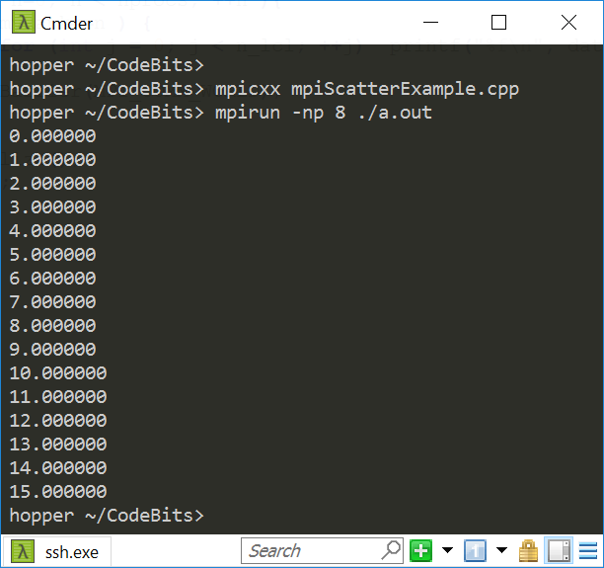
Example, MPI_Scatter
#include "mpi.h"
#include <stdlib.h>
#include <stdio.h>
void main(int argc, char **argv){
int myRank, nprocs, n_lcl=2;
float *data, *data_l;
MPI_Init(&argc, &argv);
MPI_Comm_size(MPI_COMM_WORLD, &nprocs);
MPI_Comm_rank(MPI_COMM_WORLD, &myRank);
/* local array size on each proc = n_lcl */
data_l = (float *) malloc(n_lcl*sizeof(float));
if( myRank==0 ) {
data = (float *) malloc(nprocs*sizeof(float)*n_lcl);
for( int i = 0; i < nprocs*n_lcl; ++i) data[i] = i;
}
MPI_Scatter(data, n_lcl, MPI_FLOAT, data_l, n_lcl, MPI_FLOAT, 0, MPI_COMM_WORLD);
for( int n=0; n < nprocs; ++n ){
if( myRank==n ) {
for (int j = 0; j < n_lcl; ++j) printf("%f\n", data_l[j]);
}
MPI_Barrier(MPI_COMM_WORLD); // this is interesting…
}
MPI_Finalize();
}
This is interesting…
What happens here?

Slide 43
MPI Communication Actions: Putting Things in Perspective…
Scatter: create a distributed array from a serial one
Also a more general form: MPI_Scatterv
Gaps are allowed between messages in source data
But the individual messages must still be contiguous
Irregular message sizes are allowed
Data can be distributed to processes in any order
Gather: create a serial array from a distributed one
Also a more general form: MPI_Gatherv
Counterpart to MPI_Scatterv
NOTE: there is a MPI_Allgather flavor, more on this later (Allreduce)

Slide 44
[New subtopic]Collective Actions: Operations
Combine data from several processes to produce a single result
sum=?
200
15
10
30
300
[ICHEC]→

Slide 45
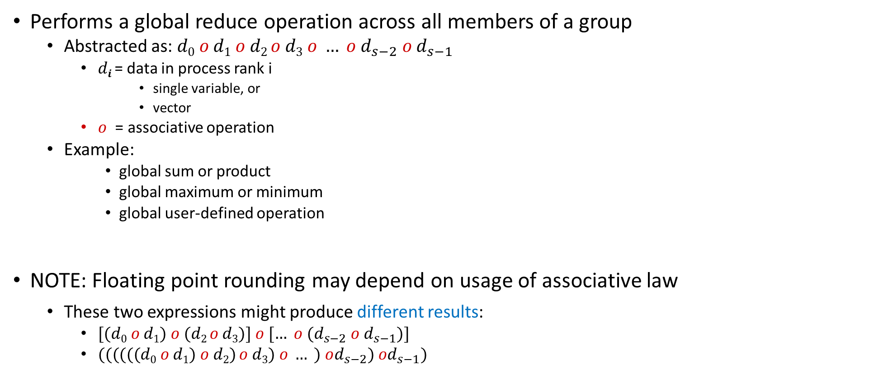
Global Reduction Operations
Performs a global reduce operation across all members of a group
Abstracted as: $d0 o d1 o d2 o d3 o … o d_{s−2} o d_{s−1}$
$di$ = data in process rank i
single variable, or
vector
$o$ = associative operation
Example:
global sum or product
global maximum or minimum
global user-defined operation
NOTE: Floating point rounding may depend on usage of associative law
These two expressions might produce different results:
$[(d0 o d1) o (d2 o d3)] o [… o (d_{s−2} o d_{s−1})]$
$((((((d0 o d1) o d2) o d3) o … ) od_{s−2}) od_{s−1})$
[ICHEC]→

Slide 46
Example of Global Reduction
Global integer sum
Sum of all inbuf values should be returned in resultbuf
The result is only placed in resultbuf at the root process.
MPI_Reduce(&inbuf, &resultbuf, 1, MPI_INT, MPI_SUM, root, MPI_COMM_WORLD);
[ICHEC]→

Slide 47
Predefined Reduction Operations
Predefined operation handle | Function
MPI_MAX | Maximum
MPI_MIN | Minimum
MPI_SUM | Sum
MPI_PROD | Product
MPI_LAND | Logical AND
MPI_BAND | Bitwise AND
MPI_LOR | Logical OR
MPI_BOR | Bitwise OR
MPI_LXOR | Logical exclusive OR
MPI_BXOR | Bitwise exclusive OR
MPI_MAXLOC | Maximum and location of the maximum
MPI_MINLOC | Minimum and location of the minimum

Slide 48
MPI_Reduce
before MPI_REDUCE
inbuf
result
A
B
C
D
E
F
G
H
I
J
K
L
M
N
O
o
o
o
o
after
A
B
C
D
E
F
G
H
I
J
K
L
M
N
O
root=1
AoDoGoJoM
[ICHEC]→

Slide 49
Reduce Operation
data (input buffer)
data (output buffer)
A0 | B0 | C0
A1 | B1 | C1
A2 | B2 | C2
A0+A1+A2 | B0+B1+B2 | C0+C1+C2
processes
reduce
Assumption: Rank 0 is the root
[A. Siegel]→

Slide 50
Example, MPI_Reduce
MPI_Reduce(sbuf,rbuf,6,MPI_INT,MPI_SUM,0,MPI_COMM_WORLD)
root (where result is reported)
output
buffer
sbuf
# entries in each rank
P0
3
4
2
8
12
1
+
rbuf
P1
5
2
5
1
7
11
P0
11
16
20
22
24
18
+
P2
2
4
4
10
4
5
+
P3
1
6
9
3
1
1
11

Slide 51
MPI_Reduce
Function prototype
int MPI_Reduce(void *sndbuf, void *rcvbuf, int count, MPI_Datatype datatype, MPI_Op op, int root, MPI_Comm comm);
IN sndbuf (address of send buffer)
OUT rcvbuf (address of receive buffer)
IN count (number of elements in send buffer)
IN datatype (data type of elements in send buffer)
IN op (reduce operation)
IN root (rank of root process)
IN comm (communicator)
[A. Siegel]→

Slide 52
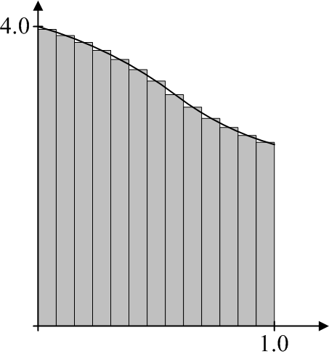
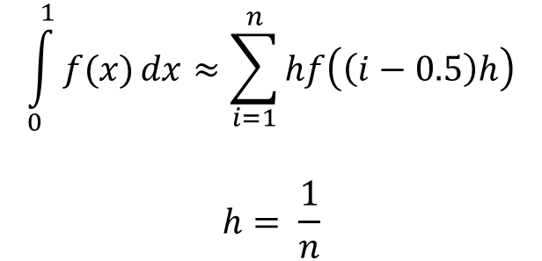
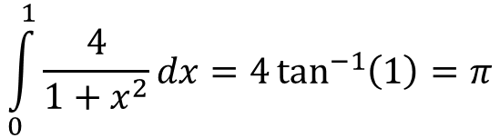
MPI Example: computing an integral (approximating $π$)
$$\int_{0}^{1}{\frac{4}{1+x^{2}}}dx=4\tan^{−1}\left(1\right)=π$$
Numerical Integration: Midpoint rule
$$\int_{0}^{1}{f(x)}dx≈\sum_{i=1}^{n}{hf\left(\left(i−0.5\right)h\right)}$$
$$h= \frac{1}{n}$$

Slide 53
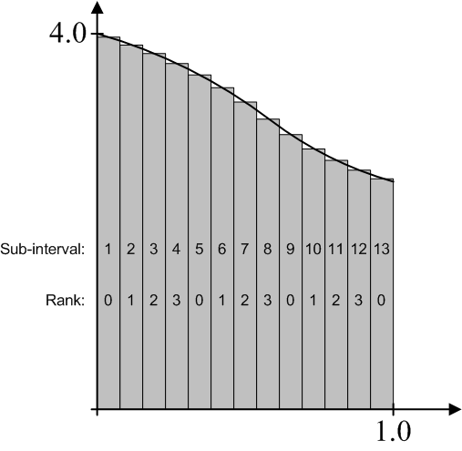
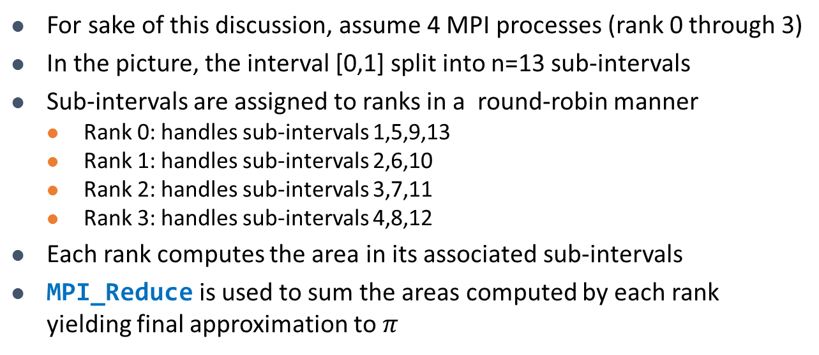
MPI Example: computing an integral (approximating $π$)
For sake of this discussion, assume 4 MPI processes (rank 0 through 3)
In the picture, the interval [0,1] split into n=13 sub-intervals
Sub-intervals are assigned to ranks in a round-robin manner
Rank 0: handles sub-intervals 1,5,9,13
Rank 1: handles sub-intervals 2,6,10
Rank 2: handles sub-intervals 3,7,11
Rank 3: handles sub-intervals 4,8,12
Each rank computes the area in its associated sub-intervals
MPI_Reduce is used to sum the areas computed by each rank yielding final approximation to $π$
[T. Heyn]→

Slide 54
MPI Example: computing an integral (approximating $π$)
#include "mpi.h"
#include <math.h>
#include <iostream>
using namespace std;
void main(int argc, char *argv[])
{
int n, rank, size, i;
double PI25DT = 3.141592653589793238462643;
double mypi, pi, h, sum, x;
char processor_name[MPI_MAX_PROCESSOR_NAME];
int namelen;
MPI_Init(&argc,&argv);
MPI_Comm_size(MPI_COMM_WORLD,&size);
MPI_Comm_rank(MPI_COMM_WORLD,&rank);
MPI_Get_processor_name(processor_name, &namelen);
cout << "Hello from process " << rank << " of " << size << " on " << processor_name << endl;

Slide 55
MPI Example: computing an integral (approximating $π$)
if (rank == 0) {
if (argc<2 || argc>2)
n=0;
else
n=atoi(argv[1]);
}
MPI_Bcast(&n, 1, MPI_INT, 0, MPI_COMM_WORLD);
if (n>0) {
h = 1.0 / (double) n;
sum = 0.0;
for (i = rank + 1; i <= n; i += size) {
x = h * ((double)i - 0.5);
sum += (4.0 / (1.0 + x*x));
}
mypi = h * sum;
MPI_Reduce(&mypi, &pi, 1, MPI_DOUBLE, MPI_SUM, 0, MPI_COMM_WORLD);
if (rank == 0)
cout << "pi is approximately " << pi << ", Error is " << fabs(pi - PI25DT) << endl;
}
MPI_Finalize();
}
How many instances of this data type are moved around
Data type we are moving around
Reduce through a “sum” operation
Root process, it ends up storing the result
Partial contribution of “this” process
Where the reduce operation stores the result

Slide 56
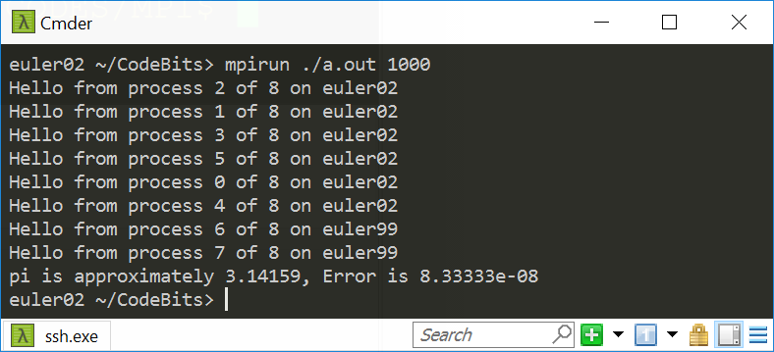
Program Output [uses 8 ranks to compute integral]

Slide 57
MPI_Reduce, MPI_Allreduce
MPI_Reduce: result is collected by the root only
The operation is applied element-wise for each element of the input arrays on each processor
MPI_Allreduce: result is sent out to all ranks in the communicator
...
MPI_Reduce(x, r, 10, MPI_INT, MPI_MAX, 0, MPI_COMM_WORLD)
...
input array
output array
array size
root
...
MPI_Allreduce(x, r, 10, MPI_INT, MPI_MAX, MPI_COMM_WORLD)
...
Credit: Allan Snavely

Slide 58
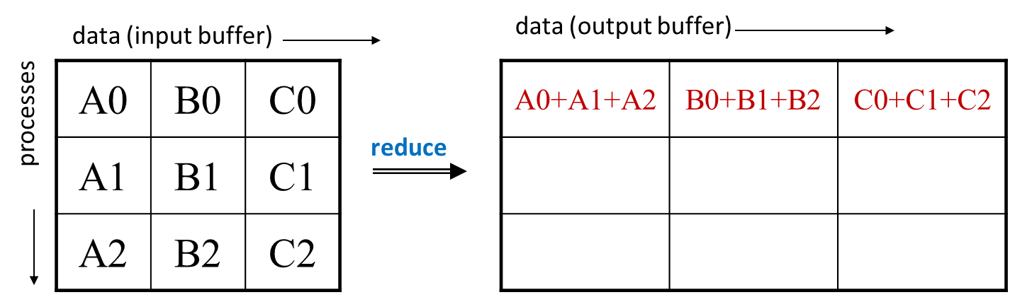
MPI_Allreduce
Here’s what MPI_Reduce does
data (buffer)
data (buffer)
A0 | B0 | C0
A1 | B1 | C1
A2 | B2 | C2
A0+A1+A2 | B0+B1+B2 | C0+C1+C2
A0+A1+A2 | B0+B1+B2 | C0+C1+C2
A0+A1+A2 | B0+B1+B2 | C0+C1+C2
processes
Allreduce
[A. Siegel]→

Slide 59
MPI_Allreduce
Function prototype
int MPI_Allreduce(void *sendbuf, void *recvbuf, int count, MPI_Datatype datatype, MPI_Op op, MPI_Comm cmm);
IN sendbuf (address of send buffer)
OUT recvbuf (address of receive buffer)
IN count (number of elements in send buffer)
IN datatype (data type of elements in send buffer)
IN op (reduce operation)
IN cmm (communicator)

Slide 60
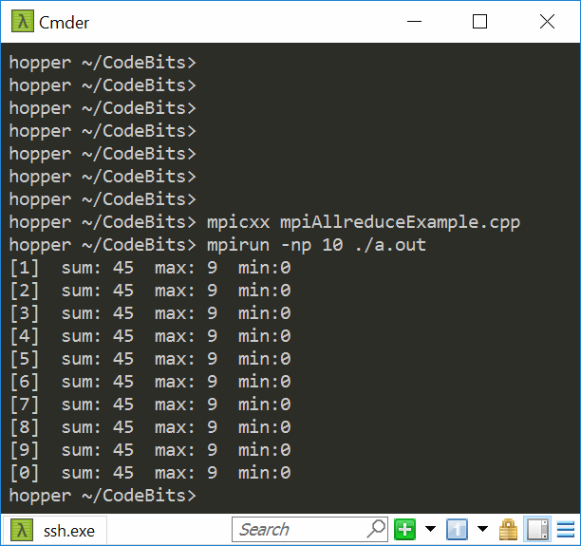
Example, MPI_Allreduce
#include "mpi.h"
#include <stdio.h>
#include <stdlib.h>
int main(int argc, char **argv) {
int myRank, nprocs, gsum, gmax, gmin;
MPI_Init(&argc, &argv);
MPI_Comm_size(MPI_COMM_WORLD, &nprocs);
MPI_Comm_rank(MPI_COMM_WORLD, &myRank);
MPI_Allreduce(&myRank, &gsum, 1, MPI_INT, MPI_SUM, MPI_COMM_WORLD);
MPI_Allreduce(&myRank, &gmax, 1, MPI_INT, MPI_MAX, MPI_COMM_WORLD);
MPI_Allreduce(&myRank, &gmin, 1, MPI_INT, MPI_MIN, MPI_COMM_WORLD);
printf([[%d] sum: %d max: %d min:%d\n", myRank, gsum, gmax, gmin);
MPI_Finalize();
return 0;
}

Slide 61
MPI_Scan
Performs a prefix reduction on data distributed across a communicator
The operation returns, in the receive buffer of the process with rank i, the reduction of the values in the send buffers of processes with ranks 0,...,i (inclusive)
Type of operations supported, their semantics, and constraints on send/receive buffers are as for MPI_REDUCE

Slide 62
MPI_Scan
before MPI_SCAN
inbuf
result
A
B
C
D
E
F
G
H
I
J
K
L
M
N
O
o
o
o
o
after
A
B
C
D
E
F
G
H
I
J
K
L
M
N
O
A
AoD
AoDoG
AoDoGoJ
AoDoGoJoM
done in parallel
[ICHEC]→

Slide 63
MPI_Scan: Quick example
Process $i$ receives data reduced on process 0 through i
sbuf
rbuf
P0
3
4
2
8
12
1
P0
3
4
2
8
12
1
P1
5
2
5
1
7
11
P1
8
6
7
9
19
12
P2
2
4
4
10
4
5
P2
10
10
11
19
23
17
P3
1
6
9
3
1
1
P3
11
16
12
22
24
18
6 entries
MPI_Scan(sbuf,rbuf,6,MPI_INT,MPI_SUM,MPI_COMM_WORLD)
[A. Snavely]→

Slide 64
Scan Operation [inclusive flavor of it; there’s also an exclusive flavor]
data (input buffer)
data (output buffer)
A0 | B0 | C0
A1 | B1 | C1
A2 | B2 | C2
A0 | B0 | C0
A0+A1 | B0+B1 | C0+C1
A0+A1+A2 | B0+B1+B2 | C0+C1+C2
processes
scan
[A. Siegel]→

Slide 65
MPI_Scan
Function prototype
int MPI_Scan(void *sendbuf, void *recvbuf, int count, MPI_Datatype datatype, MPI_Op op, MPI_Comm comm);
IN sendbuf (address of send buffer)
OUT recvbuf (address of receive buffer)
IN count (number of elements in send buffer)
IN datatype (data type of elements in send buffer)
IN op (reduce operation)
IN comm (communicator)
Note: count refers to total number of elements that will be received into recvbuf after operation is complete
[A. Siegel]→

Slide 66
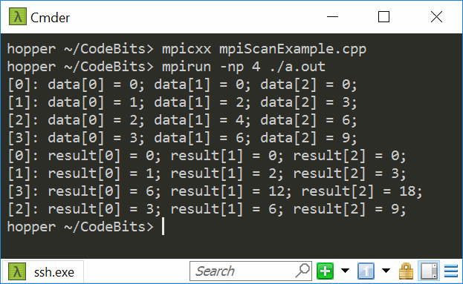
Example, MPI_Scan
#include <mpi.h>
#include <cstdio>
#include <stdio.h>
void main(int argc, char **argv) {
int myRank, nprocs;
MPI_Init(&argc, &argv);
MPI_Comm_size(MPI_COMM_WORLD, &nprocs);
MPI_Comm_rank(MPI_COMM_WORLD, &myRank);
const int dimArray = 3;
int* data_l = new int[dimArray];
for (int i = 0; i < dimArray; i++) data_l[i] = (i+1)*myRank;
for (int n = 0; n < nprocs; n++) {
MPI_Barrier(MPI_COMM_WORLD);
if (myRank == n) {
printf("[%d]: ", myRank);
for(int i = 0; i < dimArray; i++) printf("data[%d] = %d; ", i, data_l[i]);
printf("\n");
}
MPI_Barrier(MPI_COMM_WORLD);
}
int* result = new int[dimArray];
MPI_Scan(data_l, result, dimArray, MPI_INT, MPI_SUM, MPI_COMM_WORLD);
for (int n = 0; n < nprocs; n++) {
MPI_Barrier(MPI_COMM_WORLD);
if (myRank == n) {
printf("[%d]: ", myRank);
for(int i = 0; i < dimArray; i++) printf("result[%d] = %d; ", i, result[i]);
printf("\n");
}
MPI_Barrier(MPI_COMM_WORLD);
}
MPI_Finalize();
delete[] result; delete[] data_l;
}
Notes:
My attempt (via barriers) to get processes to print out in increasing order
of rank failed ☺

Slide 67
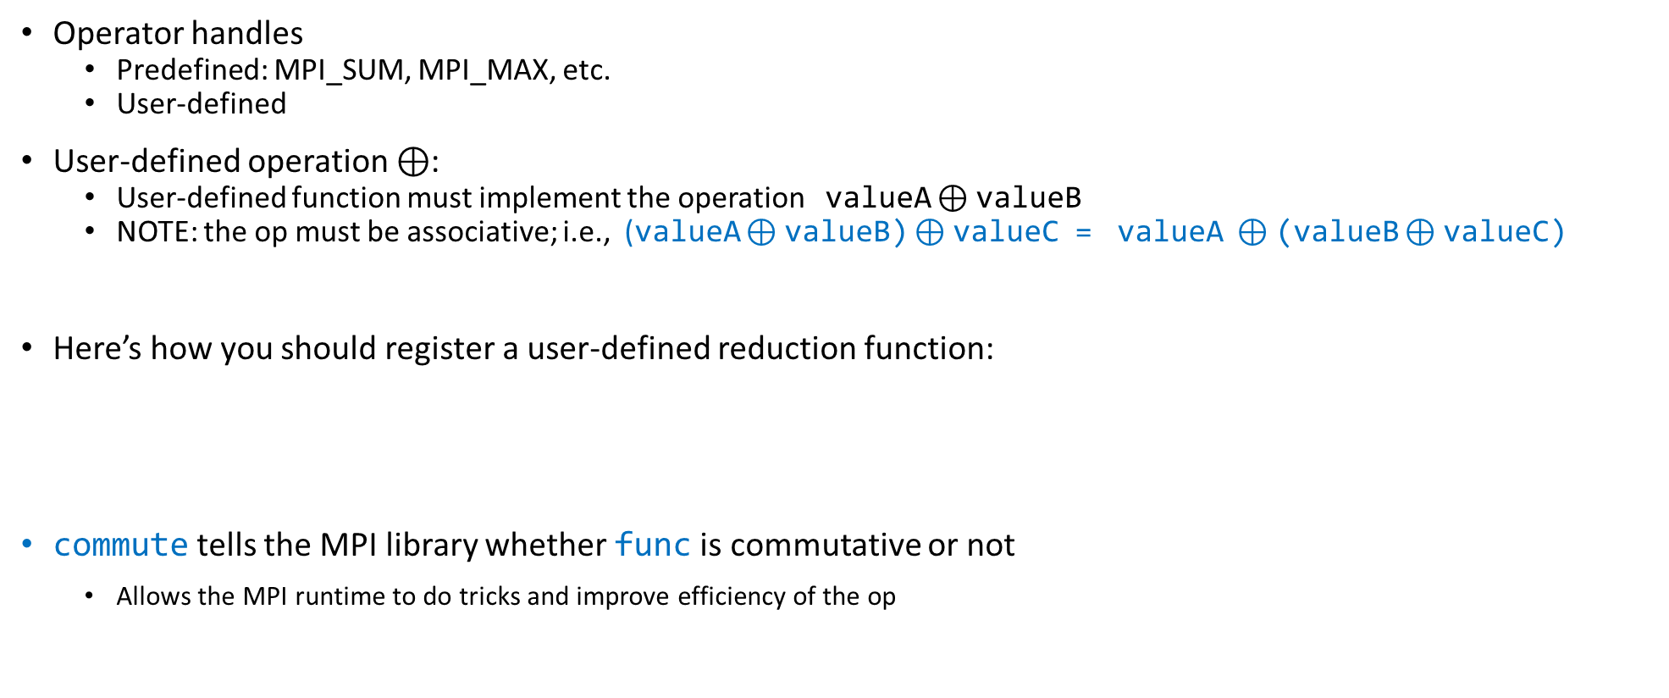
User-Defined Reduction Operations
Operator handles
Predefined: MPI_SUM, MPI_MAX, etc.
User-defined
User-defined operation $⊕$:
User-defined function must implement the operation valueA $⊕$valueB
NOTE: the op must be associative; i.e., (valueA $⊕$valueB) $⊕$valueC = valueA $⊕$(valueB $⊕$valueC)
Here’s how you should register a user-defined reduction function:
commute tells the MPI library whether func is commutative or not
Allows the MPI runtime to do tricks and improve efficiency of the op
MPI_Op_create( MPI_User_function *func, int commute, MPI_Op *op);
[ICHEC]→

Slide 68
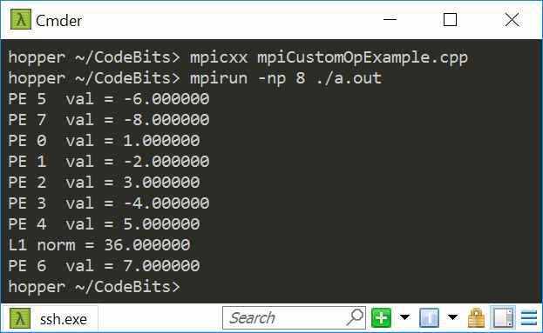
Example, MPI_Op_create
#include <cmath>
#include <cstdio>
#include <mpi.h>
#include <stdio.h>
void norm1(double *a, double *b, int *len, MPI_Datatype *type) {
*b = std::abs(*a) + std::abs(*b);
}
void main(int argc, char **argv) {
int my_rank, p;
MPI_Init(&argc, &argv);
MPI_Comm_rank(MPI_COMM_WORLD, &my_rank);
MPI_Comm_size(MPI_COMM_WORLD, &p);
MPI_Op my_op;
MPI_Op_create((MPI_User_function *)norm1, 1, &my_op);
double sendbuf = (my_rank + 1.0) * std::pow(-1.0, my_rank);
printf("PE %d val = %f\n", my_rank, sendbuf);
double recvbuf;
MPI_Reduce(&sendbuf, &recvbuf, 1, MPI_DOUBLE, my_op, 0, MPI_COMM_WORLD);
if (my_rank == 0) printf("L1 norm = %f\n", recvbuf);
MPI_Finalize();
}

Slide 69
thrust code typically much simpler
#include <thrust/transform_reduce.h>
#include <thrust/device_vector.h>
#include <thrust/host_vector.h>
#include <cmath>
template <typename T> struct absval {
__host__ __device__
T operator()(const T& x) const {
return fabs(x);
}
};
int main(void) {
// initialize host array
float x[4] = {1.0, -2.0, 3.0, -4.0};
// transfer to device
thrust::device_vector<float> d_x(x, x + 4);
absval<float> unary_op;
float res = thrust::transform_reduce(d_x.begin(), d_x.end(), unary_op, 0.f, thrust::plus<float>());
std::cout << res << std::endl;
return 0;
}

Slide 70
MPI Derived Types [Describing Non-contiguous and Heterogeneous Data]

Slide 71
The Relevant Question
The relevant question that we want to be able to answer:
“What’s in your buffer?”
Communication mechanisms discussed so far allow send/recv of a contiguous buffer of identical elements of predefined data types
Often one wants to send non-homogenous elements (structure) or chunks that are not contiguous in memory
MPI enables you to define derived datatypes to answer the question “What’s in your buffer?”

Slide 72
MPI Datatypes
MPI Primitive Datatypes
MPI_CHAR, MPI_FLOAT, MPI_INTEGER, etc.
Derived Data types - can be constructed by four methods:
contiguous
vector
indexed
struct
which can be subsequently used in all point-to-point and collective communication
The motivation: create your own types to suit your needs
More convenient
More efficient

Slide 73
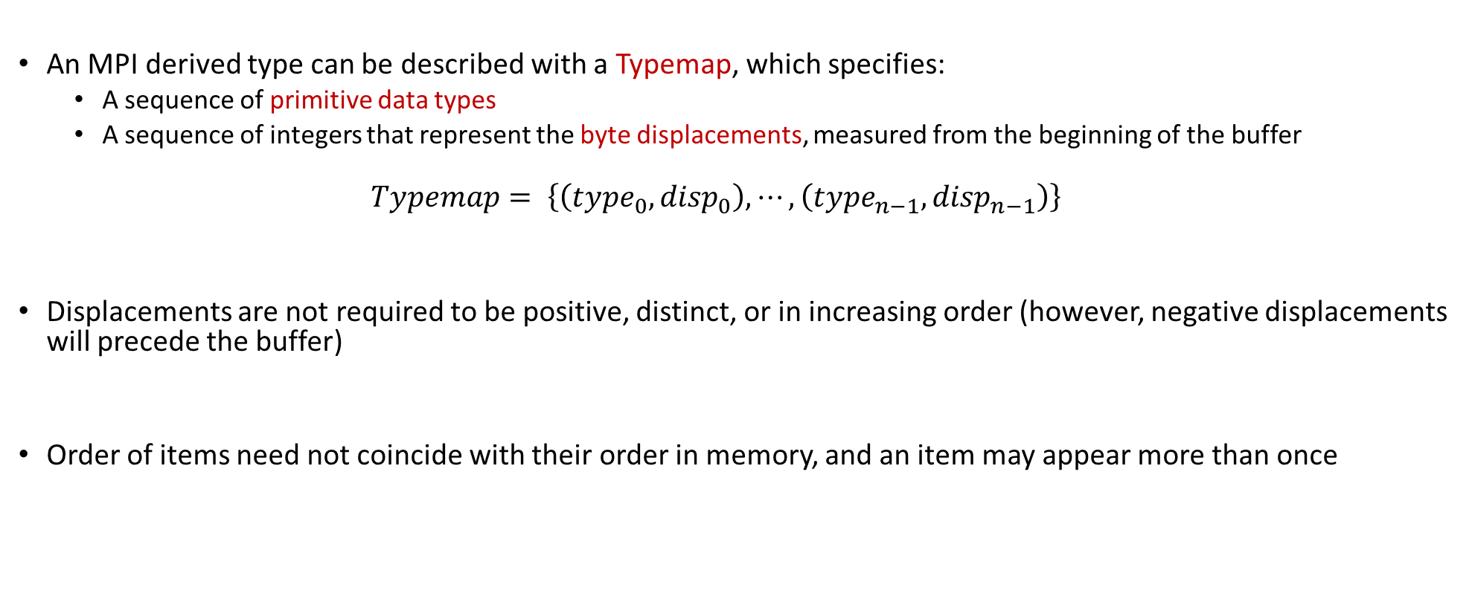
Typemaps
An MPI derived type can be described with a Typemap, which specifies:
A sequence of primitive data types
A sequence of integers that represent the byte displacements, measured from the beginning of the buffer
$$Typemap= \left\{\left({type}_{0},{disp}_{0}\right),⋯,\left({type}_{n−1},{disp}_{n−1}\right)\right\}$$
Displacements are not required to be positive, distinct, or in increasing order (however, negative displacements will precede the buffer)
Order of items need not coincide with their order in memory, and an item may appear more than once

Slide 74
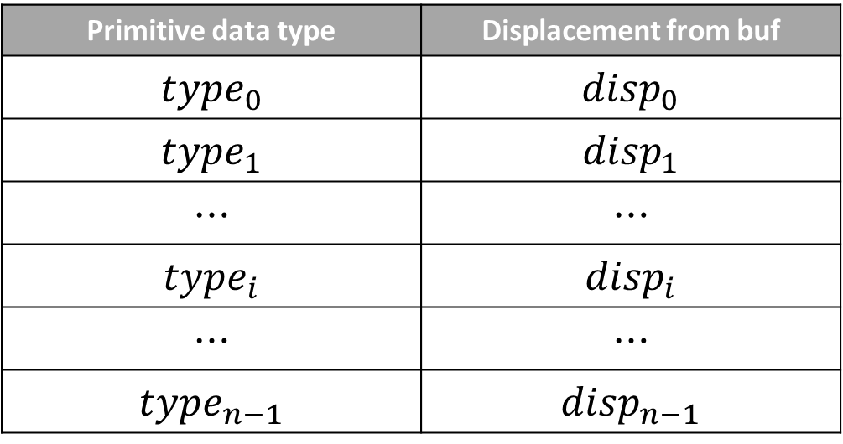
Typemaps
Primitive data type | Displacement from buf
$${type}_{0}$$ | $${disp}_{0}$$
$${type}_{1}$$ | $${disp}_{1}$$
$$⋯$$ | $$⋯$$
$${type}_{i}$$ | $${disp}_{i}$$
$$⋯$$ | $$⋯$$
$${type}_{n−1}$$ | $${disp}_{n−1}$$
Entry $i$ has type ${type}_{i}$ and displacement $buf+{disp}_{i}$

Slide 75
Extent
Extent: distance, in bytes, from beginning to end of type
More specifically, the extent of a data type is defined as:
… the span from the first byte to the last byte occupied by entries in this data type rounded up to satisfy alignment requirements
Example:
Typemap={(double,0),(char,8)} i.e. offsets of 0 and 8 respectively.
Now assume that doubles are aligned strictly at addresses that are multiples of 8
Therefore, extent = 16 (9 rounds to next multiple of 8, which is where the next double in this derived datatype would land)

Slide 76
Typemaps: Examples
What is extent of type {(char, 0), (double, 8)}?
Answer: 16
Is {(double, 8), (char, 0)} a valid type for the above?
Answer: yes, since order does not matter
What are the Typemaps of MPI_INT, MPI_DOUBLE, etc.?
Answer: {(int,0)} {(double, 0)} etc.

Slide 77
Type Signature
The sequence of primitive data types (i.e. displacements ignored) is the type signature of the data type
Example: a typemap of
{(double,0), (int,8), (char, 12)}
…has a type signature of
{double, int, char}

Slide 78
Datatype Interrogators
int MPI_Type_extent(MPI_Datatype datatype, MPI_Aint *extent);
datatype - primitive or derived datatype
extent - returns extent of datatype in bytes
datatype - primitive or derived datatype
size - returns size in bytes of the entries in the type signature of datatype
Gaps don’t contribute to size
This is the total size of the data in a message that would be created with this datatype
Entries that occur multiple times in the datatype are counted with their multiplicity
MPI_Aint - C type that holds any valid address
int MPI_Type_size(MPI_Datatype datatype, int *size);

Slide 79
Committing Datatypes
Each derived data type constructor returns an uncommited data type. Think of the commit process as a compilation of data type description into efficient internal form
Required for any derived data type before it can be used in communication
Subsequently can use in any function call where an MPI_Datatype is specified
int MPI_Type_commit (MPI_Datatype *datatype);

Slide 80
MPI_Type_free
Call to MPI_Type_free sets the value of an MPI data type to MPI_DATATYPE_NULL
Data types that were derived from the defined data type are unaffected.
int MPI_Type_free(MPI_Datatype *datatype);

Slide 81
MPI Type-Definition Functions [“constructors”]
MPI_Type_contiguous: a replication of data type into contiguous locations
MPI_Type_vector: replication of data type into locations that consist of equally spaced blocks
MPI_Type_create_hvector: like vector, but successive blocks are not multiple of base type extent
MPI_Type_indexed: non-contiguous data layout where displacements between successive blocks need not be equal
MPI_Type_create_struct: most general – each block may consist of replications of different data types
Inconsistent naming convention is unfortunate but carries no deeper meaning. It is a compatibility issue between old and new versions of MPI.
[A. Siegel]→

Slide 82
MPI_Type_contiguous
IN count (replication count)
IN oldtype (base data type)
OUT newtype (handle to new data type)
Creates a new type which is simply a replication of old type into contiguous locations
int MPI_Type_contiguous(int count, MPI_Datatype oldtype, MPI_Datatype *newtype);

Slide 83
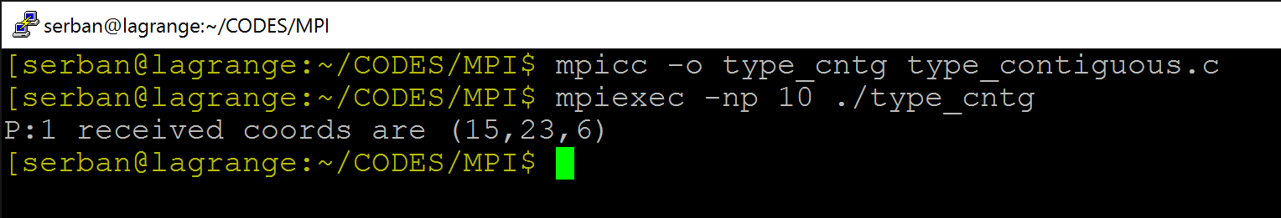
#include <stdio.h>
#include <mpi.h>
/* !!! Should be run with at least four processes !!! */
int main(int argc, char *argv[]) {
int rank;
MPI_Status status;
struct {
int x;
int y;
int z;
} point;
MPI_Datatype ptype;
MPI_Init(&argc,&argv);
MPI_Comm_rank(MPI_COMM_WORLD,&rank);
MPI_Type_contiguous(3,MPI_INT,&ptype);
MPI_Type_commit(&ptype);
if( rank==3 ){
point.x=15; point.y=23; point.z=6;
MPI_Send(&point,1,ptype,1,52,MPI_COMM_WORLD);
}
else if( rank==1 ) {
MPI_Recv(&point,1,ptype,3,52,MPI_COMM_WORLD,&status);
printf("P:%d received coords are (%d,%d,%d) \n",rank,point.x,point.y,point.z);
}
MPI_Type_free(&ptype);
MPI_Finalize();
return 0;
}

Slide 84
Motivation: MPI_Type_vector
Assume you have a 2D array of integers, and want send the last column
int x[4][8];
Content of x:
10 11 12 13 14 15 16 17
100 101 102 103 104 105 106 107
1000 1001 1002 1003 1004 1005 1006 1007
10000 10001 10002 10003 10004 10005 10006 10007
There should be a way to say that I want to transfer integers, 4 of them, and they are stored in array x, 8 integers apart (the stride)

Slide 85
MPI_Type_vector: Example
oldtype
5 element stride
between blocks
newtype
3 elements per block
2 blocks
count = 2
blocklength = 3
stride = 5

Slide 86
MPI_Type_vector
MPI_Type_vector is a constructor that allows replication of a data type into locations that consist of equally spaced blocks.
Each block is obtained by concatenating the same number of copies of the old data type
Spacing between blocks is a multiple of the extent of the old data type
One way to look at it:
You want some entries but don’t care about other entries in an array
There is a repeatability to this pattern of “wanted” and “not wanted” entries

Slide 87
MPI_Type_vector
IN count (number of blocks)
IN blocklength (number of elements per block)
IN stride (spacing between start of each block, measured as #elements)
IN oldtype (base datatype)
OUT newtype (handle to new type)
Allows replication of old type into locations of equally spaced blocks. Each block consists of same number of copies of oldtype with a stride that is multiple of extent of old type
MPI_Type_vector(int count, int blocklength, int stride, MPI_Datatype oldtype, MPI_Datatype *newtype);

Slide 88
#include <mpi.h>
#include <math.h>
#include <stdio.h>
int main(int argc, char *argv[]) {
int rank,i,j;
MPI_Status status;
double x[4][8];
MPI_Datatype coltype;
MPI_Init(&argc, &argv);
MPI_Comm_rank(MPI_COMM_WORLD,&rank);
MPI_Type_vector(4, 1, 8, MPI_DOUBLE, &coltype);
MPI_Type_commit(&coltype);
if(rank==3){
for(i=0;i<4;++i)
for(j=0;j<8;++j) x[i][j]=pow(10.0,i+1)+j;
MPI_Send(&x[0][7],1,coltype,1,52,MPI_COMM_WORLD);
}
else if(rank==1) {
MPI_Recv(&x[0][2],1,coltype,3,52,MPI_COMM_WORLD,&status);
for(i=0;i<4;++i)printf("P:%d my x[%d][2]=%1f\n",rank,i,x[i][2]);
}
MPI_Type_free(&coltype);
MPI_Finalize();
return 0;
}
count: number of blocks
blocklength: number of elements per block
stride: offset (in number of elements)
oldtype: base type
newtype: handle to derived type

Slide 89
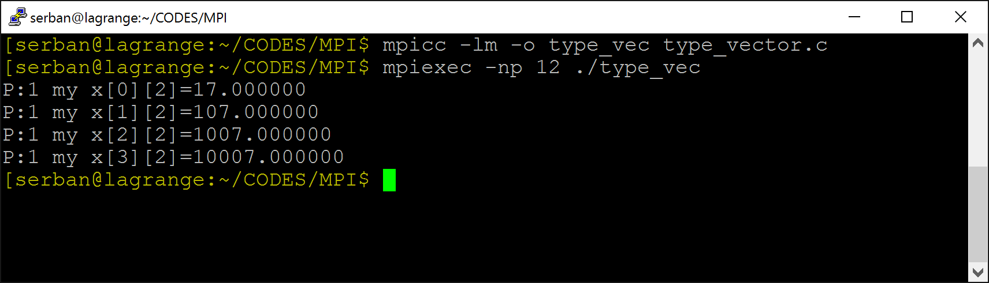
Output, Example
Content of x:
10 11 12 13 14 15 16 17
100 101 102 103 104 105 106 107
1000 1001 1002 1003 1004 1005 1006 1007
10000 10001 10002 10003 10004 10005 10006 10007

Slide 90
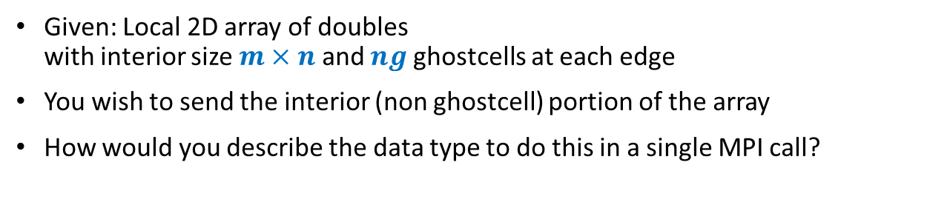


Exercise: MPI_Type_vector
Given: Local 2D array of doubles with interior size $m×n$ and $ng$ ghostcells at each edge
You wish to send the interior (non ghostcell) portion of the array
How would you describe the data type to do this in a single MPI call?
startPoint
n
$$⋯$$
m
$$⋮$$
ng
ng
MPI_Type_vector (m, n, n+2*ng, MPI_DOUBLE, &interior);
MPI_Type_commit (&interior);
MPI_Send (startPoint, 1, interior, dest, tag, MPI_COMM_WORLD);
MPI_Type_vector(int count, int blocklength, int stride, MPI_Datatype oldtype, MPI_Datatype *newtype);

Slide 91
Exercise: Typemap
Start with oldtype for which Typemap = {(double, 0), (char, 8)}
What is Typemap of newtype if defined as below? MPI_Type_vector(2, 3, 4, oldtype, &newtype)
oldtype
newtype
16
32
48
64
80
96
{{(double, 0),(char, 8)}, {(double,16),(char,24)}, {(double,32),(char, 40)}, {(double,64),(char,72)}, {(double,80),(char,88)}, {(double,96),(char,104)}}
MPI_Type_vector(int count, int blocklength, int stride, MPI_Datatype oldtype, MPI_Datatype *newtype);

Slide 92
Exercise: MPI_Type_vector
How can you express MPI_Type_contiguous(count, old, &new); as a call to MPI_Type_vector?
MPI_Type_vector (count, 1, 1, old, &new);
MPI_Type_vector (1, count, count, old, &new);
MPI_Type_vector(int count, int blocklength, int stride, MPI_Datatype oldtype, MPI_Datatype *newtype);

Slide 93
Outline, Parallel Computing w/ MPI
Introduction to message passing and MPI
Point-to-Point Communication
Collective Communication
MPI Closing Remarks

Slide 94
MPI – We’re Scratching the Surface
In some MPI implementations there are more than 300 MPI functions
Not all of them part of the MPI standard though, some vendor specific
MPI_Abort, MPI_Accumulate, MPI_Add_error_class, MPI_Add_error_code, MPI_Add_error_string, MPI_Address, MPI_Allgather, MPI_Allgatherv, MPI_Alloc_mem, MPI_Allreduce, MPI_Alltoall, MPI_Alltoallv, MPI_Alltoallw, MPI_Attr_delete, MPI_Attr_get, MPI_Attr_put, MPI_Barrier, MPI_Bcast, MPI_Bsend, MPI_Bsend_init, MPI_Buffer_attach, MPI_Buffer_detach, MPI_Cancel, MPI_Cart_coords, MPI_Cart_create, MPI_Cart_get, MPI_Cart_map, MPI_Cart_rank, MPI_Cart_shift, MPI_Cart_sub, MPI_Cartdim_get, MPI_Comm_call_errhandler, MPI_Comm_compare, MPI_Comm_create, MPI_Comm_create_errhandler, MPI_Comm_create_keyval, MPI_Comm_delete_attr, MPI_Comm_dup, MPI_Comm_free, MPI_Comm_free_keyval, MPI_Comm_get_attr, MPI_Comm_get_errhandler, MPI_Comm_get_name, MPI_Comm_group, MPI_Comm_rank, MPI_Comm_remote_group, MPI_Comm_remote_size, MPI_Comm_set_attr, MPI_Comm_set_errhandler, MPI_Comm_set_name, MPI_Comm_size, MPI_Comm_split, MPI_Comm_test_inter, MPI_Dims_create, MPI_Errhandler_create, MPI_Errhandler_free, MPI_Errhandler_get, MPI_Errhandler_set, MPI_Error_class, MPI_Error_string, MPI_Exscan, MPI_File_call_errhandler, MPI_File_close, MPI_File_create_errhandler, MPI_File_delete, MPI_File_get_amode, MPI_File_get_atomicity, MPI_File_get_byte_offset, MPI_File_get_errhandler, MPI_File_get_group, MPI_File_get_info, MPI_File_get_position, MPI_File_get_position_shared, MPI_File_get_size, MPI_File_get_type_extent, MPI_File_get_view, MPI_File_iread, MPI_File_iread_at, MPI_File_iread_shared, MPI_File_iwrite, MPI_File_iwrite_at, MPI_File_iwrite_shared, MPI_File_open, MPI_File_preallocate, MPI_File_read, MPI_File_read_all, MPI_File_read_all_begin, MPI_File_read_all_end, MPI_File_read_at, MPI_File_read_at_all, MPI_File_read_at_all_begin, MPI_File_read_at_all_end, MPI_File_read_ordered, MPI_File_read_ordered_begin, MPI_File_read_ordered_end, MPI_File_read_shared, MPI_File_seek, MPI_File_seek_shared, MPI_File_set_atomicity, MPI_File_set_errhandler, MPI_File_set_info, MPI_File_set_size, MPI_File_set_view, MPI_File_sync, MPI_File_write, MPI_File_write_all, MPI_File_write_all_begin, MPI_File_write_all_end, MPI_File_write_at, MPI_File_write_at_all, MPI_File_write_at_all_begin, MPI_File_write_at_all_end, MPI_File_write_ordered, MPI_File_write_ordered_begin, MPI_File_write_ordered_end, MPI_File_write_shared, MPI_Finalize, MPI_Finalized, MPI_Free_mem, MPI_Gather, MPI_Gatherv, MPI_Get, MPI_Get_address, MPI_Get_count, MPI_Get_elements, MPI_Get_processor_name, MPI_Get_version, MPI_Graph_create, MPI_Graph_get, MPI_Graph_map, MPI_Graph_neighbors, MPI_Graph_neighbors_count, MPI_Graphdims_get, MPI_Grequest_complete, MPI_Grequest_start, MPI_Group_compare, MPI_Group_difference, MPI_Group_excl, MPI_Group_free, MPI_Group_incl, MPI_Group_intersection, MPI_Group_range_excl, MPI_Group_range_incl, MPI_Group_rank, MPI_Group_size, MPI_Group_translate_ranks, MPI_Group_union, MPI_Ibsend, MPI_Info_create, MPI_Info_delete, MPI_Info_dup, MPI_Info_free, MPI_Info_get, MPI_Info_get_nkeys, MPI_Info_get_nthkey, MPI_Info_get_valuelen, MPI_Info_set, MPI_Init, MPI_Init_thread, MPI_Initialized, MPI_Intercomm_create, MPI_Intercomm_merge, MPI_Iprobe, MPI_Irecv, MPI_Irsend, MPI_Is_thread_main, MPI_Isend, MPI_Issend, MPI_Keyval_create, MPI_Keyval_free, MPI_Op_create, MPI_Op_free, MPI_Pack, MPI_Pack_external, MPI_Pack_external_size, MPI_Pack_size, MPI_Pcontrol, MPI_Probe, MPI_Put, MPI_Query_thread, MPI_Recv, MPI_Recv_init, MPI_Reduce, MPI_Reduce_scatter, MPI_Register_datarep, MPI_Request_free, MPI_Request_get_status, MPI_Rsend, MPI_Rsend_init, MPI_Scan, MPI_Scatter, MPI_Scatterv, MPI_Send, MPI_Send_init, MPI_Sendrecv, MPI_Sendrecv_replace, MPI_Ssend, MPI_Ssend_init, MPI_Start, MPI_Startall, MPI_Status_set_cancelled, MPI_Status_set_elements, MPI_Test, MPI_Test_cancelled, MPI_Testall, MPI_Testany, MPI_Testsome, MPI_Topo_test, MPI_Type_commit, MPI_Type_contiguous, MPI_Type_create_darray, MPI_Type_create_f90_complex, MPI_Type_create_f90_integer, MPI_Type_create_f90_real, MPI_Type_create_hindexed, MPI_Type_create_hvector, MPI_Type_create_indexed_block, MPI_Type_create_keyval, MPI_Type_create_resized, MPI_Type_create_struct, MPI_Type_create_subarray, MPI_Type_delete_attr, MPI_Type_dup, MPI_Type_extent, MPI_Type_free, MPI_Type_free_keyval, MPI_Type_get_attr, MPI_Type_get_contents, MPI_Type_get_envelope, MPI_Type_get_extent, MPI_Type_get_name, MPI_Type_get_true_extent, MPI_Type_hindexed, MPI_Type_hvector, MPI_Type_indexed, MPI_Type_lb, MPI_Type_match_size, MPI_Type_set_attr, MPI_Type_set_name, MPI_Type_size, MPI_Type_struct, MPI_Type_ub, MPI_Type_vector, MPI_Unpack, MPI_Unpack_external, MPI_Wait, MPI_Waitall, MPI_Waitany, MPI_Waitsome, MPI_Win_call_errhandler, MPI_Win_complete, MPI_Win_create, MPI_Win_create_errhandler, MPI_Win_create_keyval, MPI_Win_delete_attr, MPI_Win_fence, MPI_Win_free, MPI_Win_free_keyval, MPI_Win_get_attr, MPI_Win_get_errhandler, MPI_Win_get_group, MPI_Win_get_name, MPI_Win_lock, MPI_Win_post, MPI_Win_set_attr, MPI_Win_set_errhandler, MPI_Win_set_name, MPI_Win_start, MPI_Win_test, MPI_Win_unlock, MPI_Win_wait, MPI_Wtick, MPI_Wtime
Recall the 80/20 rule: six calls is probably what you need to implement a decent MPI code…
MPI_Init, MPI_Comm_Size, MPI_Comm_Rank, MPI_Send, MPI_Recv, MPI_Finalize

Slide 95
MPI: Textbooks, Further Reading…
MPI: A Message-Passing Interface Standard (1.1, June 12, 1995)
MPI-2: Extensions to the Message-Passing Interface (July 18,1997)
MPI: The Complete Reference, Marc Snir and William Gropp et al., The MIT Press, 1998 (2-volume set)
Using MPI: Portable Parallel Programming With the Message-Passing Interface and Using MPI-2: Advanced Features of the Message-Passing Interface. William Gropp, Ewing Lusk and Rajeev Thakur, MIT Press, 1999 – also available in a single volume ISBN 026257134X.
Parallel Programming with MPI, Peter S. Pacheco, Morgan Kaufmann Publishers, 1997 - very good introduction.
Parallel Programming with MPI, Neil MacDonald, Elspeth Minty, Joel Malard, Tim Harding, Simon Brown, Mario Antonioletti. Training handbook from EPCC
http://www.epcc.ed.ac.uk/computing/training/document_archive/mpi-course/mpi-course.pdf
[ICHEC]→

Slide 96
The PETSc Library [The message: Use libraries whenever possible]
PETSc: Portable, Extensible Toolkit for Scientific Computation
One of the most successful libraries built on top of MPI
Intended for use in large-scale application projects,
Developed at Argonne National Lab (Barry Smith)
Open source, available for download at http://www.mcs.anl.gov/petsc/petsc-as/
PETSc: routines for the parallel solution of systems of equations that arise from the discretization of PDEs
Linear systems
Nonlinear systems
Time evolution
PETSc also provides routines for
Sparse matrix assembly
Distributed arrays
General scatter/gather (e.g., for unstructured grids)

Slide 97
Structure of PETSc
PETSc PDE Numerical Solution Utilities
ODE Integrators
Visualization
Nonlinear Solvers,
Unconstrained Minimization
Interface
Linear Solvers
Preconditioners + Krylov Methods
Object-Oriented
Matrices, Vectors, Indices
Grid
Management
Profiling Interface
Computation and Communication Kernels
MPI, MPI-IO, BLAS, LAPACK

Slide 98
PETSc Numerical Components
Nonlinear Solvers
Time Steppers
Newton-based Methods
Other
Euler
Backward
Euler
Pseudo Time
Stepping
Other
Line Search
Trust Region
Krylov Subspace Methods
GMRES
CG
CGS
Bi-CG-STAB
TFQMR
Richardson
Chebychev
Other
Preconditioners
Additive
Schwartz
Block
Jacobi
Jacobi
ILU
ICC
LU
(Sequential only)
Others
Matrices
Compressed
Sparse Row
(AIJ)
Blocked Compressed
Sparse Row
(BAIJ)
Block
Diagonal
(BDIAG)
Dense
Matrix-free
Other
Distributed Arrays
Index Sets
Vectors
Indices
Block Indices
Stride
Other

Slide 99
Flow Control for PDE Solution
Main Routine
Timestepping Solvers (TS)
Nonlinear Solvers (SNES)
Linear Solvers (SLES)
PETSc
PC
KSP
Application
Initialization
Function
Evaluation
Jacobian
Evaluation
Post-
Processing
User code
PETSc code
Notes:
Scalable Linear Equations Solvers (SLES)

Slide 100
Additional Material

Slide 101
MPI_Exscan
MPI_Exscan is like MPI_Scan, except that the contribution from the calling process is not included in the result at the calling process (it is contributed to the subsequent processes)
The value in recvbuf on the process with rank 0 is undefined, and recvbuf is not signficant on process 0
The value in recvbuf on the process with rank 1 is defined as the value in sendbuf on the process with rank 0
For processes with rank i > 1, the operation returns, in the receive buffer of the process with rank i, the reduction of the values in the send buffers of processes with ranks 0,...,i-1 (inclusive)
The type of operations supported, their semantics, and the constraints on send and receive buffers, are as for MPI_REDUCE

Slide 102
MPI_Exscan
Function prototype
int MPI_Exscan (void *sendbuf, void *recvbuf, int count, MPI_Datatype datatype, MPI_Op op, MPI_Comm cmm);
IN sendbuf (address of send buffer)
OUT recvbuf (address of receive buffer)
IN count (number of elements in send buffer)
IN datatype (data type of elements in send buffer)
IN op (reduce operation)
IN cmm (communicator)
[A. Siegel]→

Slide 103
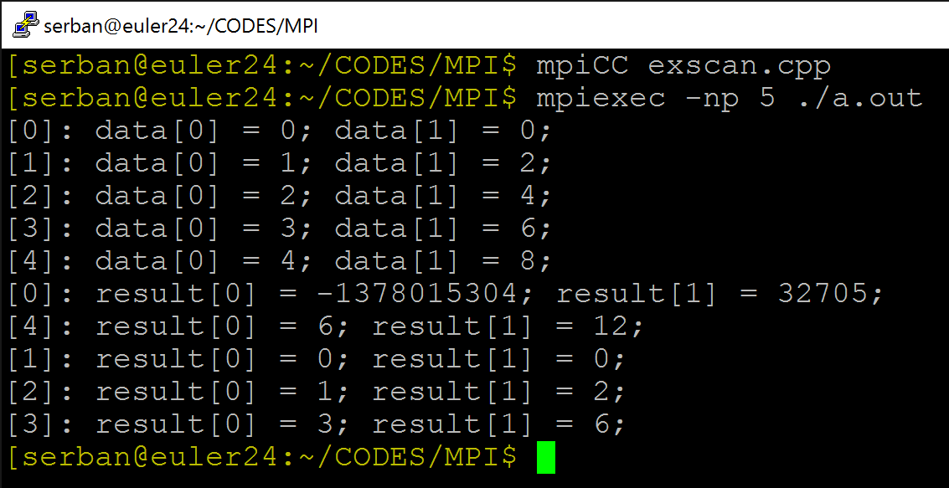

#include <mpi.h>
#include <cstdio>
void main(int argc, char **argv) {
int myRank, nprocs;
MPI_Init(&argc, &argv);
MPI_Comm_size(MPI_COMM_WORLD, &nprocs);
MPI_Comm_rank(MPI_COMM_WORLD, &myRank);
const int dimArray = 2;
int* data_l = new int[dimArray];
for (int i = 0; i < dimArray; i++) data_l[i] = (i+1)*myRank;
for (int n = 0; n < nprocs; n++) {
if (myRank == n) {
printf("[%d]: ", myRank);
for(int i = 0; i < dimArray; i++) printf("data[%d] = %d; ", i, data_l[i]);
printf("\n");
}
MPI_Barrier(MPI_COMM_WORLD);
}
int* result = new int[dimArray];
MPI_Exscan(data_l, result, dimArray, MPI_INT, MPI_SUM, MPI_COMM_WORLD);
for (int n = 0; n < nprocs; n++) {
if (myRank == n) {
printf("[%d]: ", myRank);
for(int i = 0; i < dimArray; i++) printf("result[%d] = %d; d", i, data_l[i]);
printf("\n");
}
MPI_Barrier(MPI_COMM_WORLD);
}
MPI_Finalize();
delete[] result;
delete[] data_l;
}
Example: MPI_Exscan
[Radu Serban]$→$

Slide 104
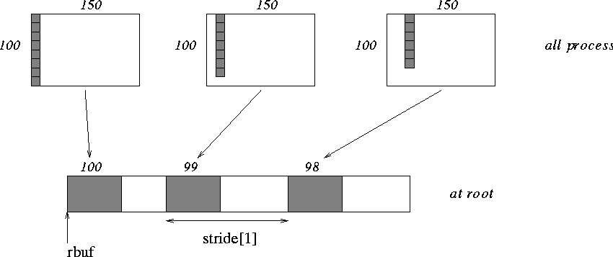
MPI_Gatherv
Function Prototype
int MPI_Gatherv(const void *sendbuf, int sendcount, MPI_Datatype sendtype,
void *recvbuf, const int *recvcounts, const int *displs,
MPI_Datatype recvtype, int root, MPI_Comm comm)
[MPI-forum]→

Slide 105
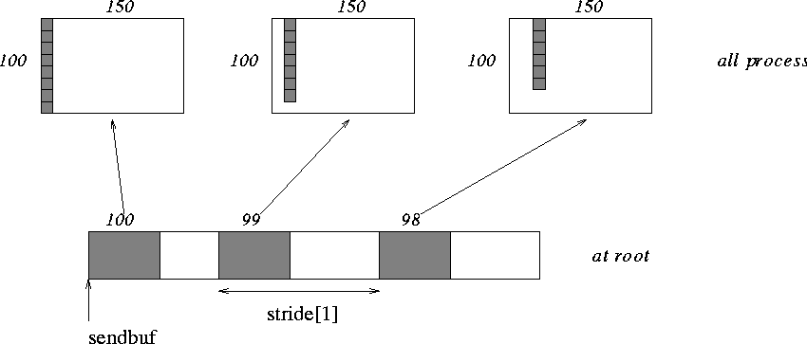
MPI_Scatterv
Function Prototype
int MPI_Scatterv(const void *sendbuf, const int *sendcounts, const int *displs,
MPI_Datatype sendtype, void *recvbuf, int recvcount,
MPI_Datatype recvtype,
int root, MPI_Comm comm)
[MPI-forum]→

Slide 106
ME759 Wrap Up

Slide 107
Course Objectives [slide of January 22, 2020]
Get familiar with today’s software and hardware that can speed up your code
Mostly done through parallel computing, at multiple levels
Recognize applications/problems that can draw on advanced computing
Gain basic skills that will help you map these applications onto a parallel computing hardware/software stack
Write code, build, link, run, debug, profile
Introduce basic software design patterns for parallel computing
Expand your mindset when it comes to writing software for scientific computing

Slide 108
ME759: Opportunities for Efficiency Gains Discussed
Efficiency Gain Opport.
Hardware asset coming into play
Software Enabler
Cluster (distributed mem.)
Group of nodes communicate through fast interconnect
MPI, Charm++, Chapel
Multi-Socket Node
Group of CPUs on the same node, talk through main mem.
OpenMP, MPI
Acceleration (GPU/Phi)
Compute devices accelerating parallel computation on one node
CUDA, OpenCL, OpenMP
Multi-Core Processor
Communication through shared caches and main mem.
OpenMP, TBB, pthreads
Vectorization
Higher operation throughput via special/fat registers
AVX, SSE
Pipelining
Sequence of instruction sharing functional units
Assembly
Superscalar
Non-sequence instructions sharing functional units
Assembly
We have full control →
We have little to no control →

Slide 109
Skills I hope You Picked Up in ME759
I think of these as items that you can claim to be familiar with during an interview:
Basic understanding of what happens on one core
Basic understanding of hardware for parallel computing
CUDA programming
OpenMP Programming
MPI Programming, scratched the surface
Understanding of the parallel computing model induced by each solution; i.e., MPI, OpenMP, or CUDA
Understanding that data movement dictates performance

Slide 110
ME759: Everything compressed on one slide
Know your hardware
Don’t move data around
Energy and time expensive
Seek solutions that expose concurrency/parallelism
Use the tools of the trade to work like a pro, and then get paid like a pro
Use debuggers, profilers, CMake, memory checkers, compiler flags, git, etc.

Slide 111
Quote of the day, yet again
“Human beings only use ten percent of their brains. Ten percent! Can you imagine how much we could accomplish if we used the other sixty percent?”
Ellen DeGeneres, American comedian, television host, actress, writer, and producer [1958 - ]

Slide 112
Perhaps the most important thing: keep thinking & exploring
ME759 was about convincing you that there is “the other 60%” that you can tap into
What “the other 60%” is continuously changing
To keep using “the other 60%,” you’ll have to keep reading, thinking, and exploring

Slide 113
Don’t look at ME759 as a fish. Pick up the fishing
“If you give a man a fish he is hungry again in an hour. If you teach him to catch a fish you do him a good turn.”
Anne Isabella Thackeray Ritchie, English writer [1837 –1919]
(also in the Chinese, Jewish, Navajo, Italian, etc., folklore)

Slide 114
Perhaps the most important thing: keep thinking & exploring
ME759 was about convincing you that there is “the other 60%” that you can tap into
What “the other 60%” is continuously changing
To keep using “the other 60%,” you’ll have to keep reading, thinking, and exploring
In an ideal world, ME759 taught you how to fish. Not hand you a fish

Slide 115
Email, April 2, 2019 [shown with permission]
Dear Dan,
I took your HPC course in Spring 2018, and really enjoyed it. I did an internship with ANSYS in Summer 2018 and I was able to significantly improve their code performance because of the course.
Initially, their code did not scale as expected. I found a line in the code where the size of an array was being changed inside a nested loop. I changed this and fixed the slowdown. The performance went from O(N^2) to the expected O(NlogN). Now that the code was scaling as expected, we were able to publish it (along with some other material) as an SAE paper. I have attached the paper here. I will be presenting it next week in Detroit.
I just wanted to let you know of this, and thank you for the great course!
Regards,
Arpit Agarwal
4th year Ph.D. student
Mario Trujillo's group

Slide 116
End of 759.
Thank you.
Don’t forget to write.

